Slide 1

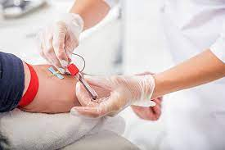

Appointment Scheduler for Sample Collection

Slide 2
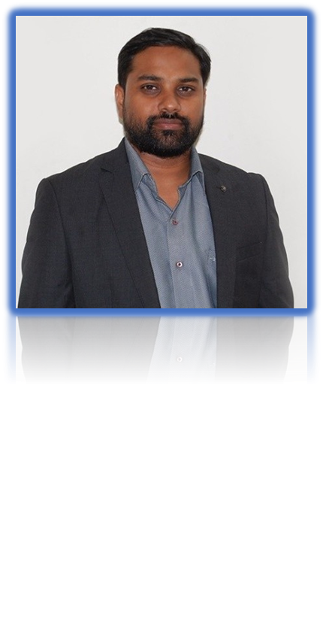
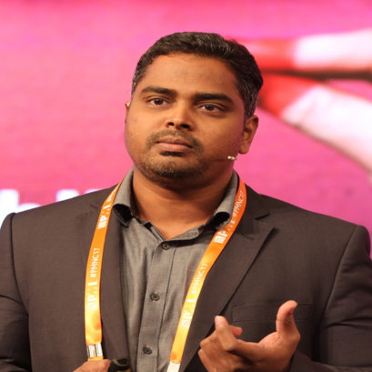

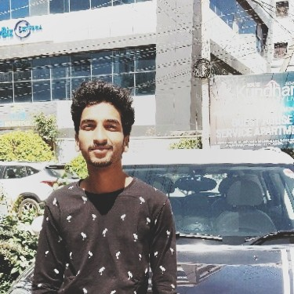
TEAM MENTORS
Mr. Sharath Manikonda
Director : Innodatatics
https://www.linkedin.com/in/sharat-chandra
Mr. BHARANI KUMAR DEPURU
Director : 360 Digi TMG
https://www.linkedin.com/in/bharanikumardepuru
Ms. DivyaJanani S
Project Mentor
https://www.linkedin.com/in/divyajanani-s-256981211
Mekala Madhan Kumar
Project Mentor
https://www.linkedin.com/in/mekala-madhan-kumar-348014194/

Slide 3



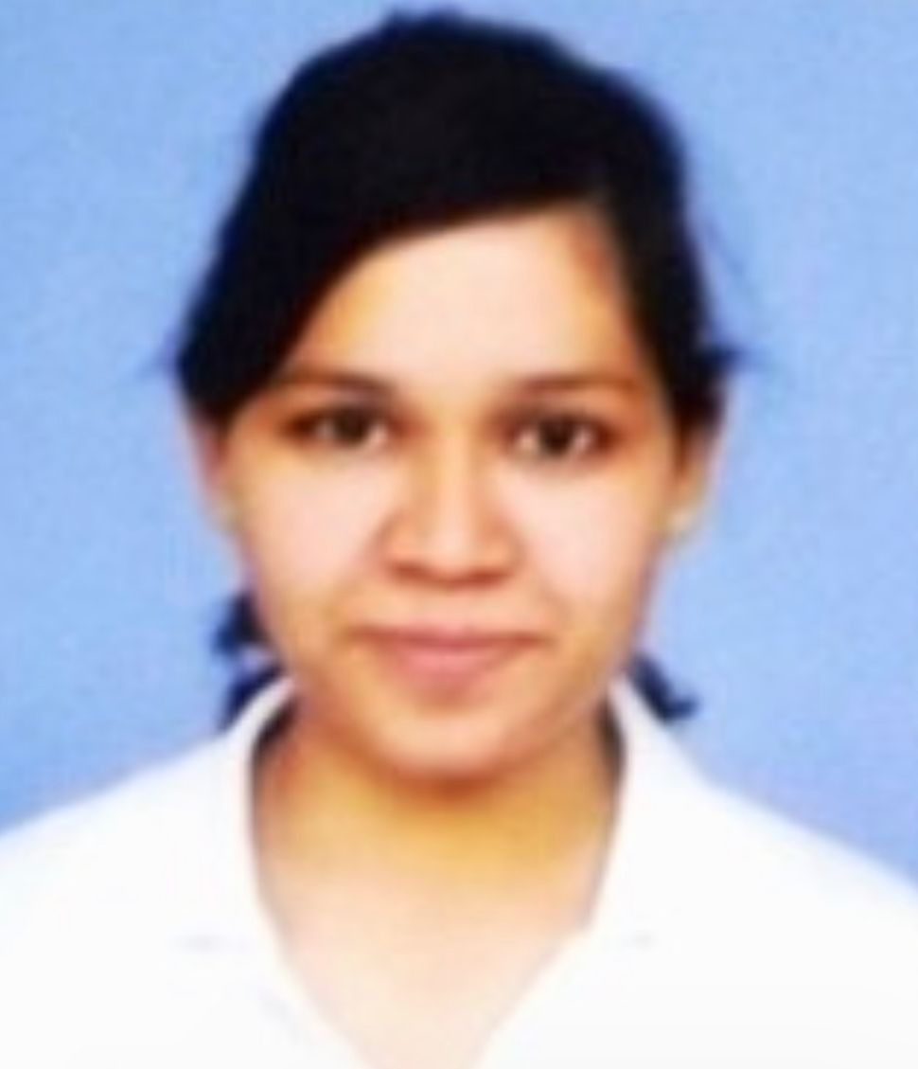
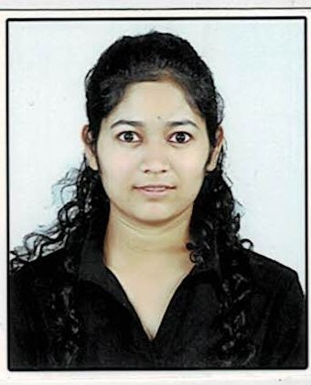
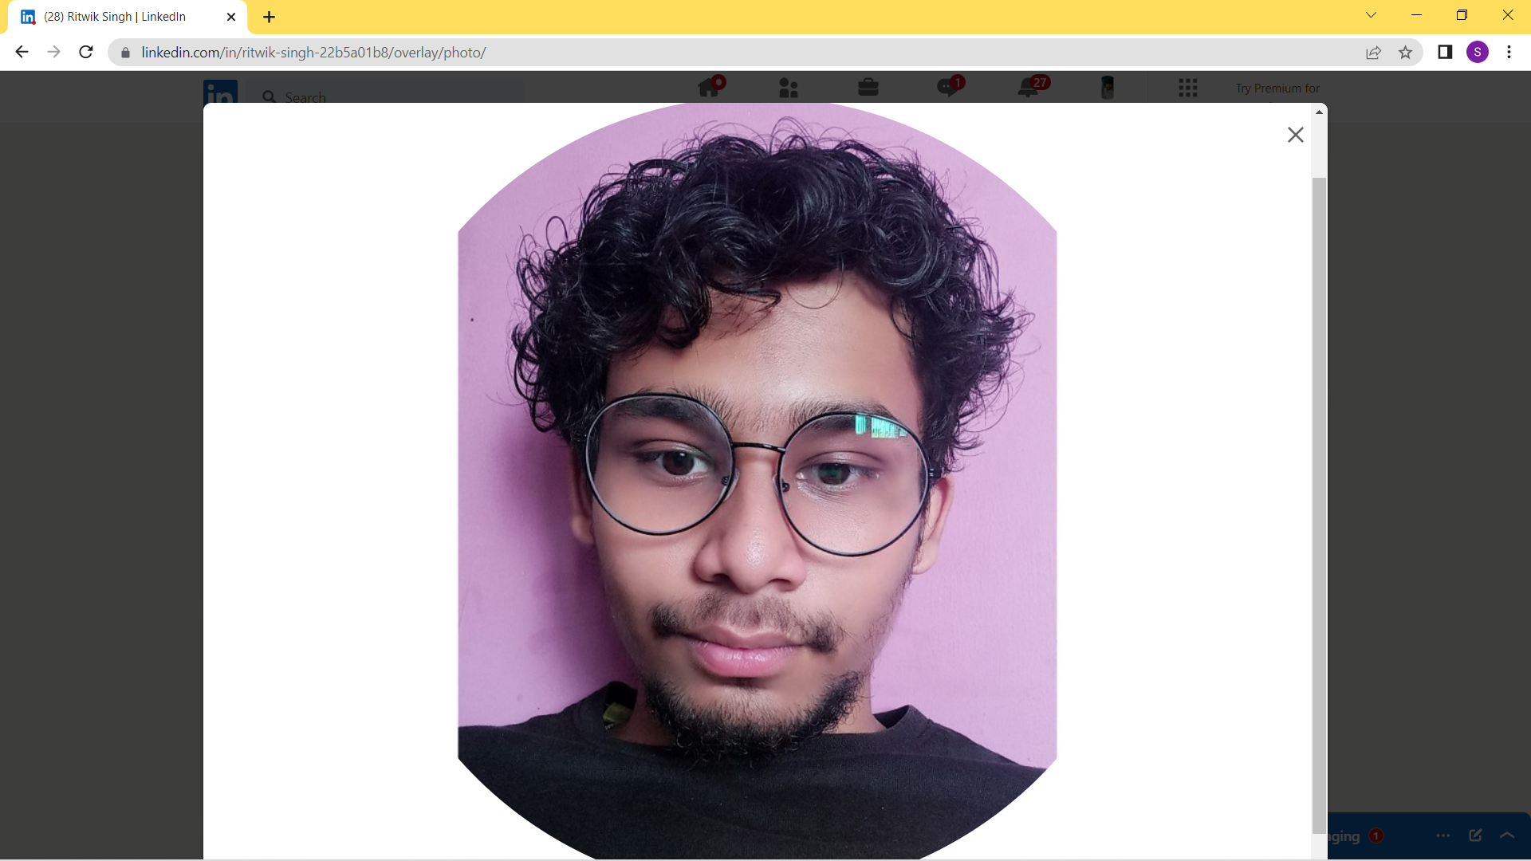
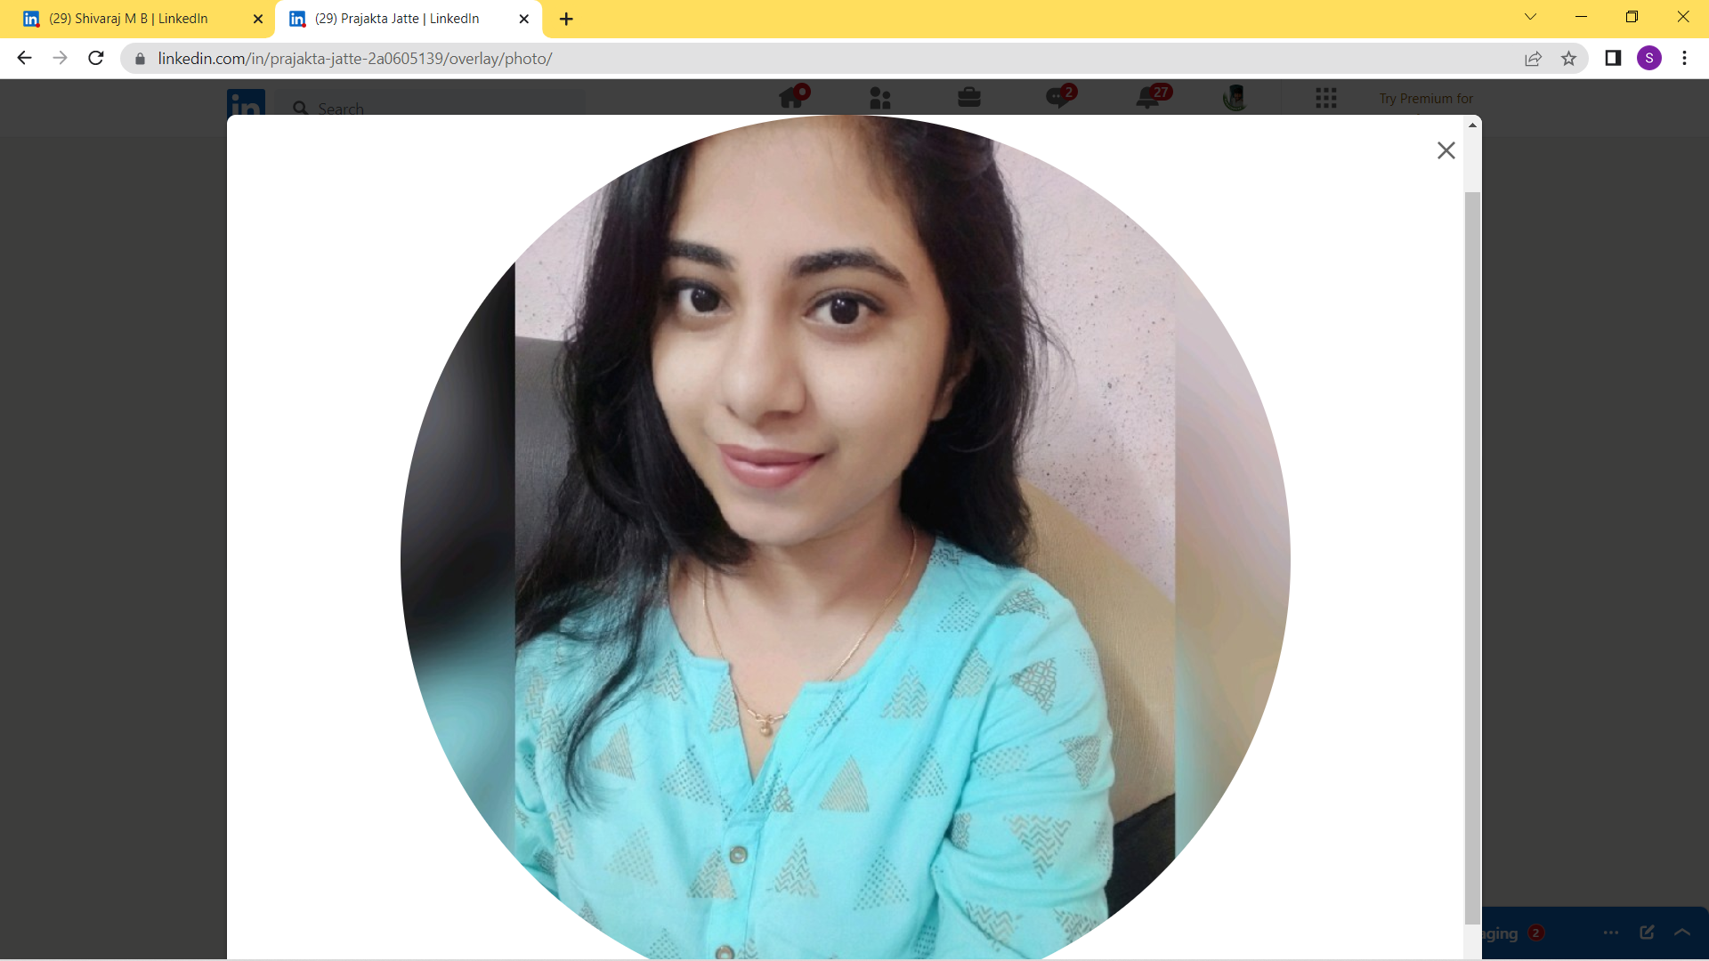
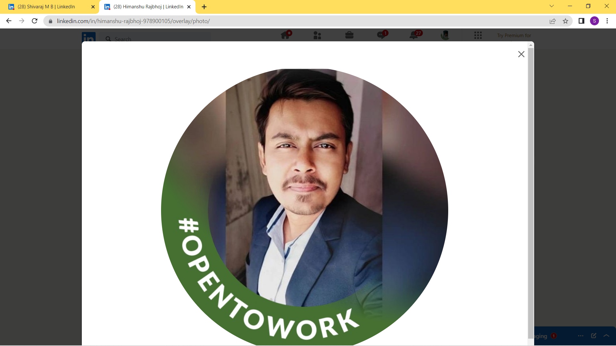
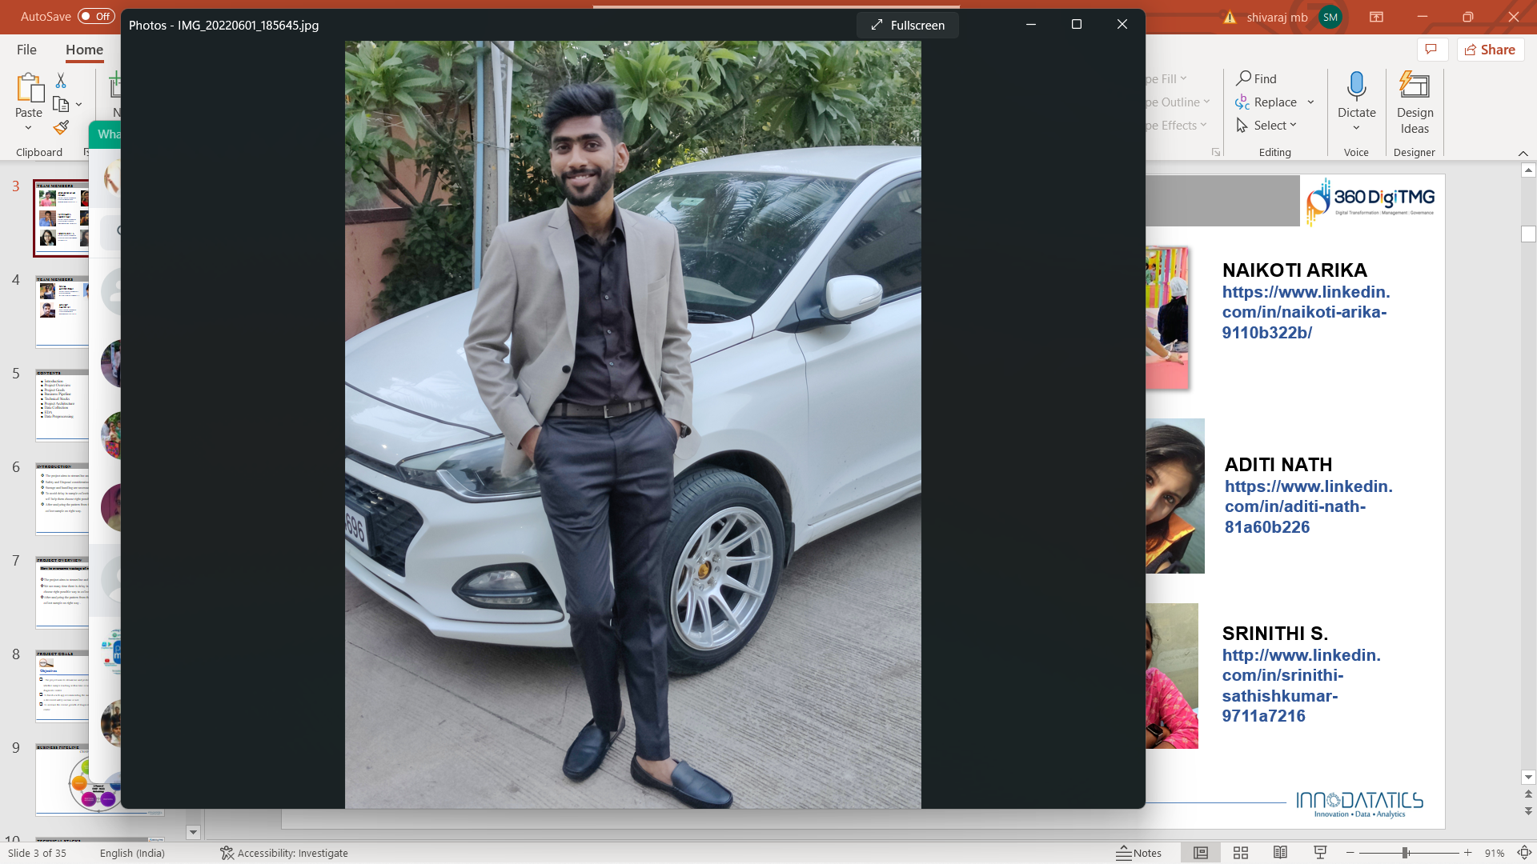
TEAM MEMBERS
MONALI SAHARE
http://www.linkedin.com/in/monali-s-92a25916
SHUBHAM S DANDEKAR
https://www.linkedin.com/in/shubham-dandekar-a959b41b0
AKASH JHADHAV
https://www.linkedin.com/in/akash-jadhav-6177781b4
PRITI KANDARI
https://www.linkedin.com/in/priti-kandari-14778941
DHANSHRI PATIL
https://www.linkedin.com/in/dhanashri-patil-088664239
RITVIK SINGH
https://www.linkedin.com/in/ritwik-singh-22b5a01b8
HIMANSHU R
https://www.linkedin.com/in/himanshu-rajbhoj-978900105
PRAJAKTA JATTE
https://www.linkedin.com/in/prajakta-jatte-2a0605139
SHIVRAJ M B
https://www.linkedin.com/in/shivaraj-m-b-91942a219

Slide 4



TEAM MEMBERS
AKSHAY KALMEGH
https://www.linkedin.com/in/akshay-kalmegh-260058212
VINAYAK PATIL
https://www.linkedin.com/in/vinayak-patil-888ab4171
ANAND M
www.linkedin.com/in/
anand-manoj-513546226

Slide 5
CONTENTS
Introduction
Project Overview
Project Goals
Business Pipeline
Technical Stacks
Project Architecture
Data Collection
EDA
Data Preprocessing
Data Visualization
Model Building
Model Selection
Model Deployment
Working of deployed model
Output
Future scope
Conclusion

Slide 6
INTRODUCTION
The project aims to streamline and give proper schedule for sample collection.
Safety and Disposal considerations in Specimen Collection.
Storage and handling are necessary to maintain the integrity of time.
To avoid delay in sample collection and deliverables to diagnostic centers, the ML model will help to give schedule for sample collection.
After analyzing the pattern from the data, the model will help the diagnostic centers to collect sample on time.

Slide 7

PROJECT OVERVIEW
How to overcome wastage of medical sample?:-
How can our model help this?
The project aims to streamline and give proper schedule for sample collection.
We see many time there is delay in sample collection so this model will try to give proper schedule for sample collection in future.
After analyzing the pattern from the data, the model will help the diagnostic center to collect sample on time.

Slide 8

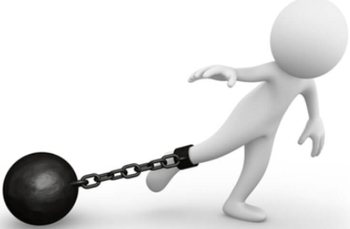
PROJECT GOALS
Objectives
Constraints
The model may get impacted by unforeseen conditions like weather ,traffic conditions
The unavailability of patient and agent at the scheduled time.
Minimize sample loss
Maximize the productivity of sample collection agent.

Slide 9
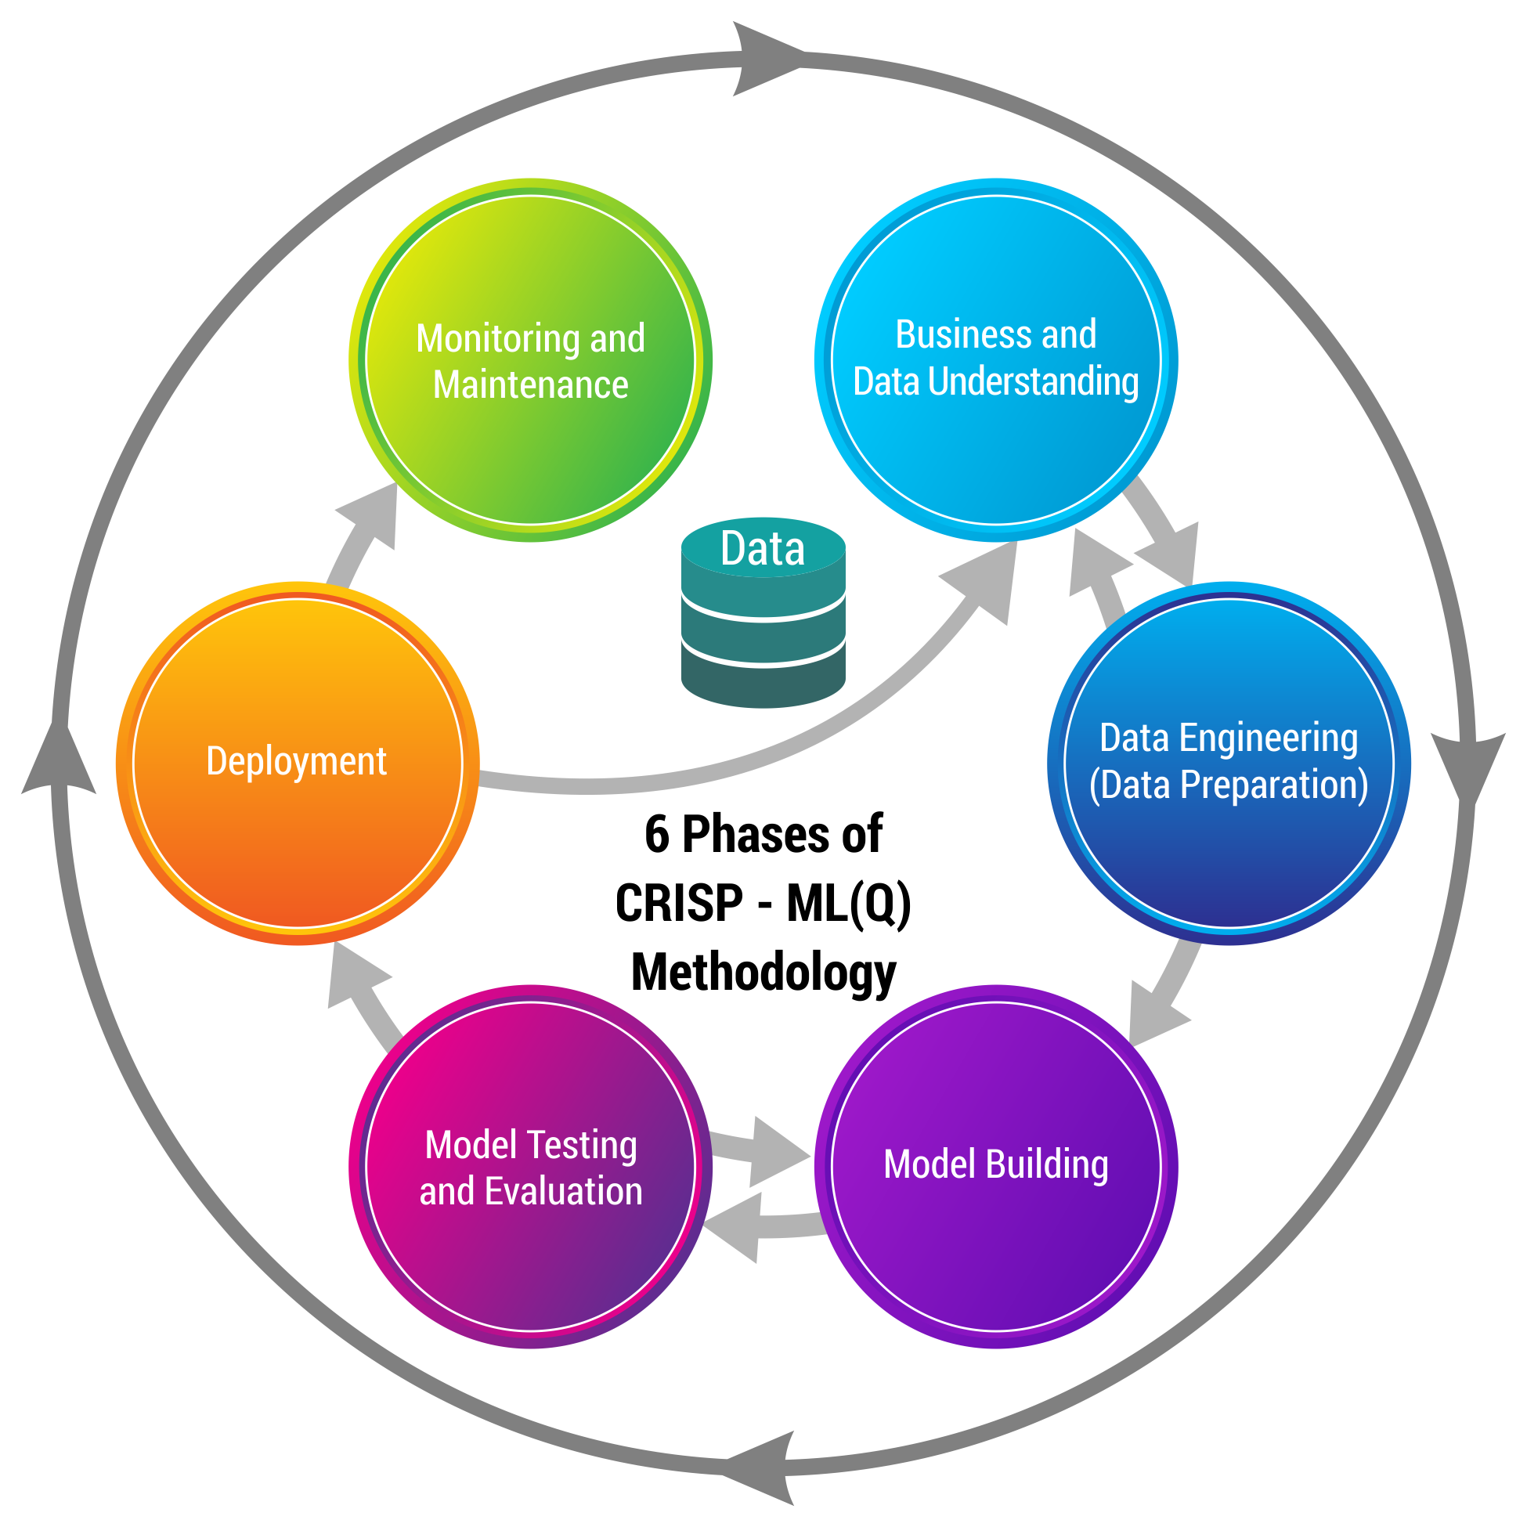
BUSINESS PIPELINE
CRISP-ML(Q) Methodology

Slide 10








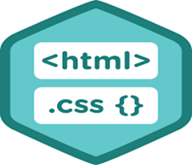



TECHNICAL STACKS
MySQL - used to import and export data into database.
Data Visualization
Python - Used for Data Collection, Data pre-processing
and Model Building
Flask, Streamlit, HTML and CSS – used for building Web Application.
The IDEs essential building blocks, include advanced editing, code analytical tools, IPython Console, variable explorer, plots, debugger and the help
Heroku - used for Web Application deployment.
Serializing & Deserializing

Slide 11
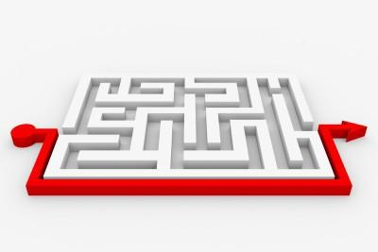
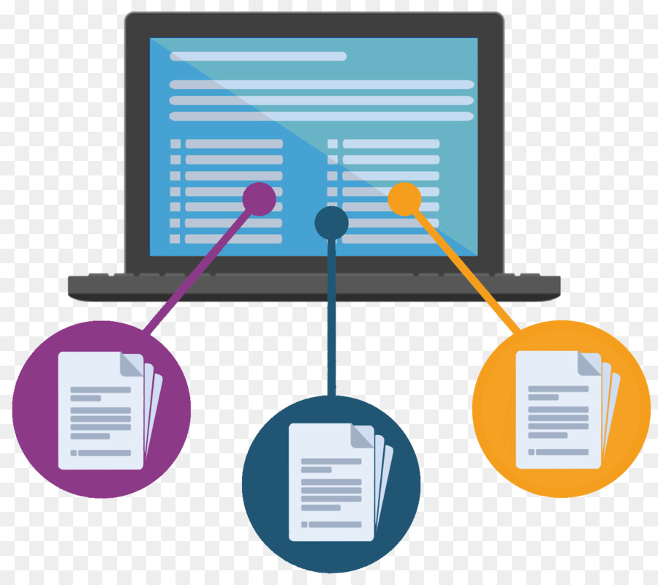









PROJECT ARCHITECTURE
Business and Data Understanding
Data Collection
Data Preparation
Streamlit
Heroku
Model Building
Monitoring & Maintenance
MySQL
Model Evaluation
Deployment
Model Selection

Slide 12

DATA COLLECTION

Slide 13

DATA COLLECTION
Data was simulated one. Certain inputs were collected from diagnostic centers. Finalized collected data was framed in excel into structured format.
Dataset has following features:-
Patient ID : ID Given to the patient on booking the first test.
Agent ID : ID of the agent who is going to pick and deliver the sample to the lab (Limited to 1 to 50)
Pincode : Pincode of patient location
Patient Location : Location of Patient
Latitudes and Longitudes (Patient) : Latitudes and Longitudes of Patient Location
Latitudes and Longitudes (Agent) : Latitudes and Longitudes of Agent Location
Latitudes and Longitudes (Diagnostic Center) : Latitudes and Longitudes of Diagnostic center
Diagnostic Centers : Name of Diagnostic Centers
Time slot : 3 different time slot as per patient
shortest distance Agent-Pathlab(m) : Shortest distance between agent and Diagnostic Center in meter
shortest distance Patient-Pathlab(m) : Shortest distance between patient and Diagnostic Center in meter
shortest distance Patient-Agent(m) : Shortest distance between patient and agent in meter
Availability time (Patient) : Availability time of patient

Slide 14
DATA COLLECTION
Age : Age of the patient
Gender : Gender of the patient
Test Booking Date : The date on which the test was booked
Test Booking Time HH:MM : Time of the day when the test was booked (24 hours) (ex. 19:50 means 7 hour 50 minutes)
Test name : Name of Test to be performed after sample collection
Sample : Type of sample collected (Urine, Blood, Swab)
Way Of Storage Of Sample : How the sample is stored while transporting. (Disposable plastic container, Vaccum blood collection tube, Urine culture transport tube )
Sample Collection Date : The date on which the sample should be collected.
Time taken for sample collection : Time taken by the agent to collect the sample from the patient (in minutes)
Time Agent-Pathlab sec : Time taken by Agent to reach Diagnostic Center in Seconds.
Agent Arrival Time (range) HH:MM : Range of Agent Arrival Time.
Exact Arrival Time MM : Time at which agent arrived at Patient location in minutes.

Slide 15

EXPLORATORY DATA ANALYSIS(EDA)

Slide 16
EXPLORATORY DATA ANALYSIS (EDA)
Dataset Statistics:
Number of variables : 26
Number of observations : 1304
Missing values found : 0
Duplicate rows found : 0
Total size in memory : 115 KB
Variable Types:
Categorical : 21
Numerical : 5
Date Types : 2

Slide 17
DATA PRE-PROCESSING
Data Preprocessing Techniques Applied:
Missing data handling: No missing values found.
Duplicate data: No duplicate data observed.
Relevant data: Only relevant variables are considered for model building.
OneHotEncoding or
LabelEncoding: Categorical encoding in which a new binary feature for each
possible category and assigns a value of 1 to the feature of each
sample that corresponds to its original category.
Note: No outliers treatment was performed since every data is unique, same data was retained.
Raw Data
Structured Data
Data Preprocessing
EDA
Visual Graphs

Slide 18
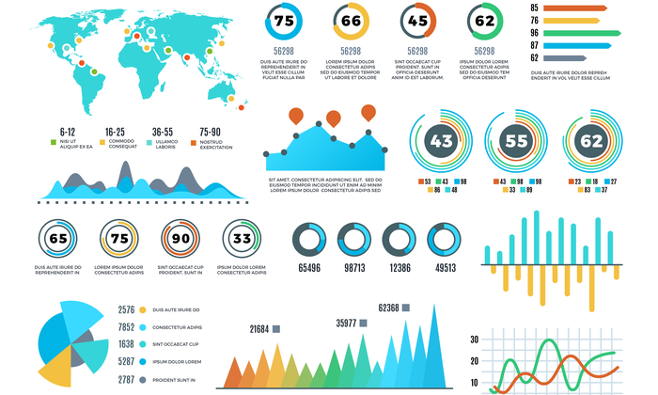
DATA VISUALIZATION

Slide 19

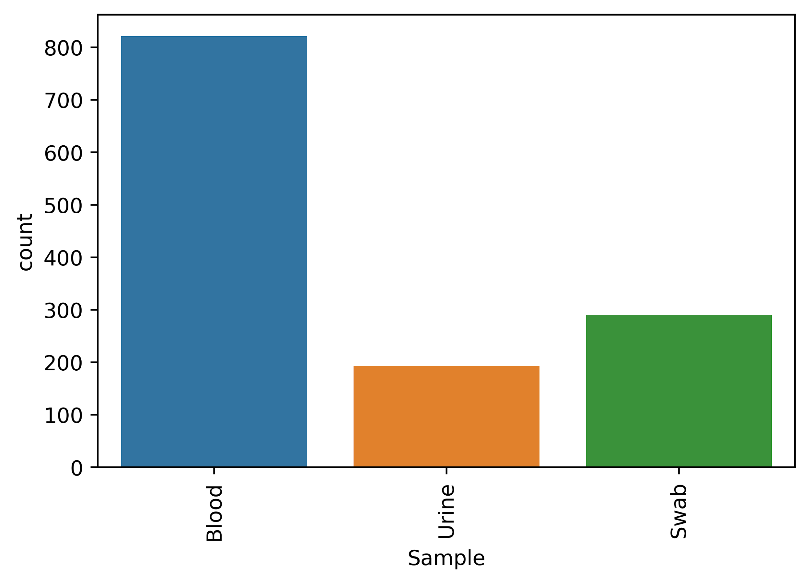
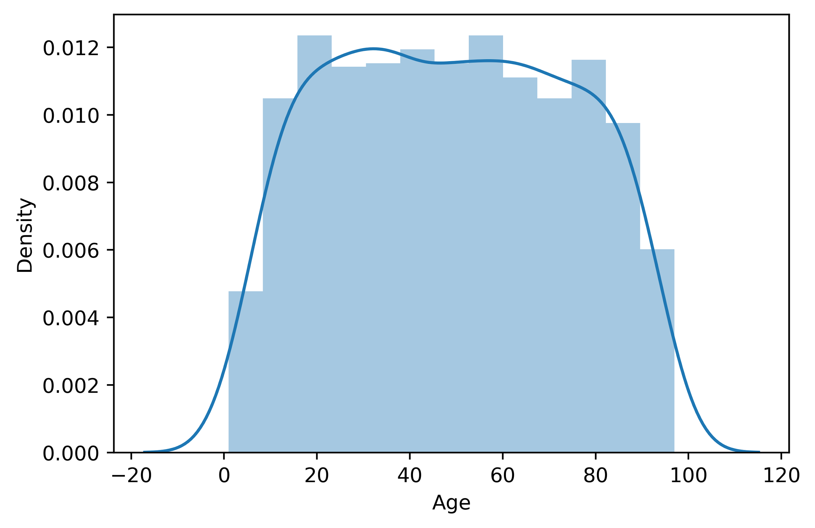
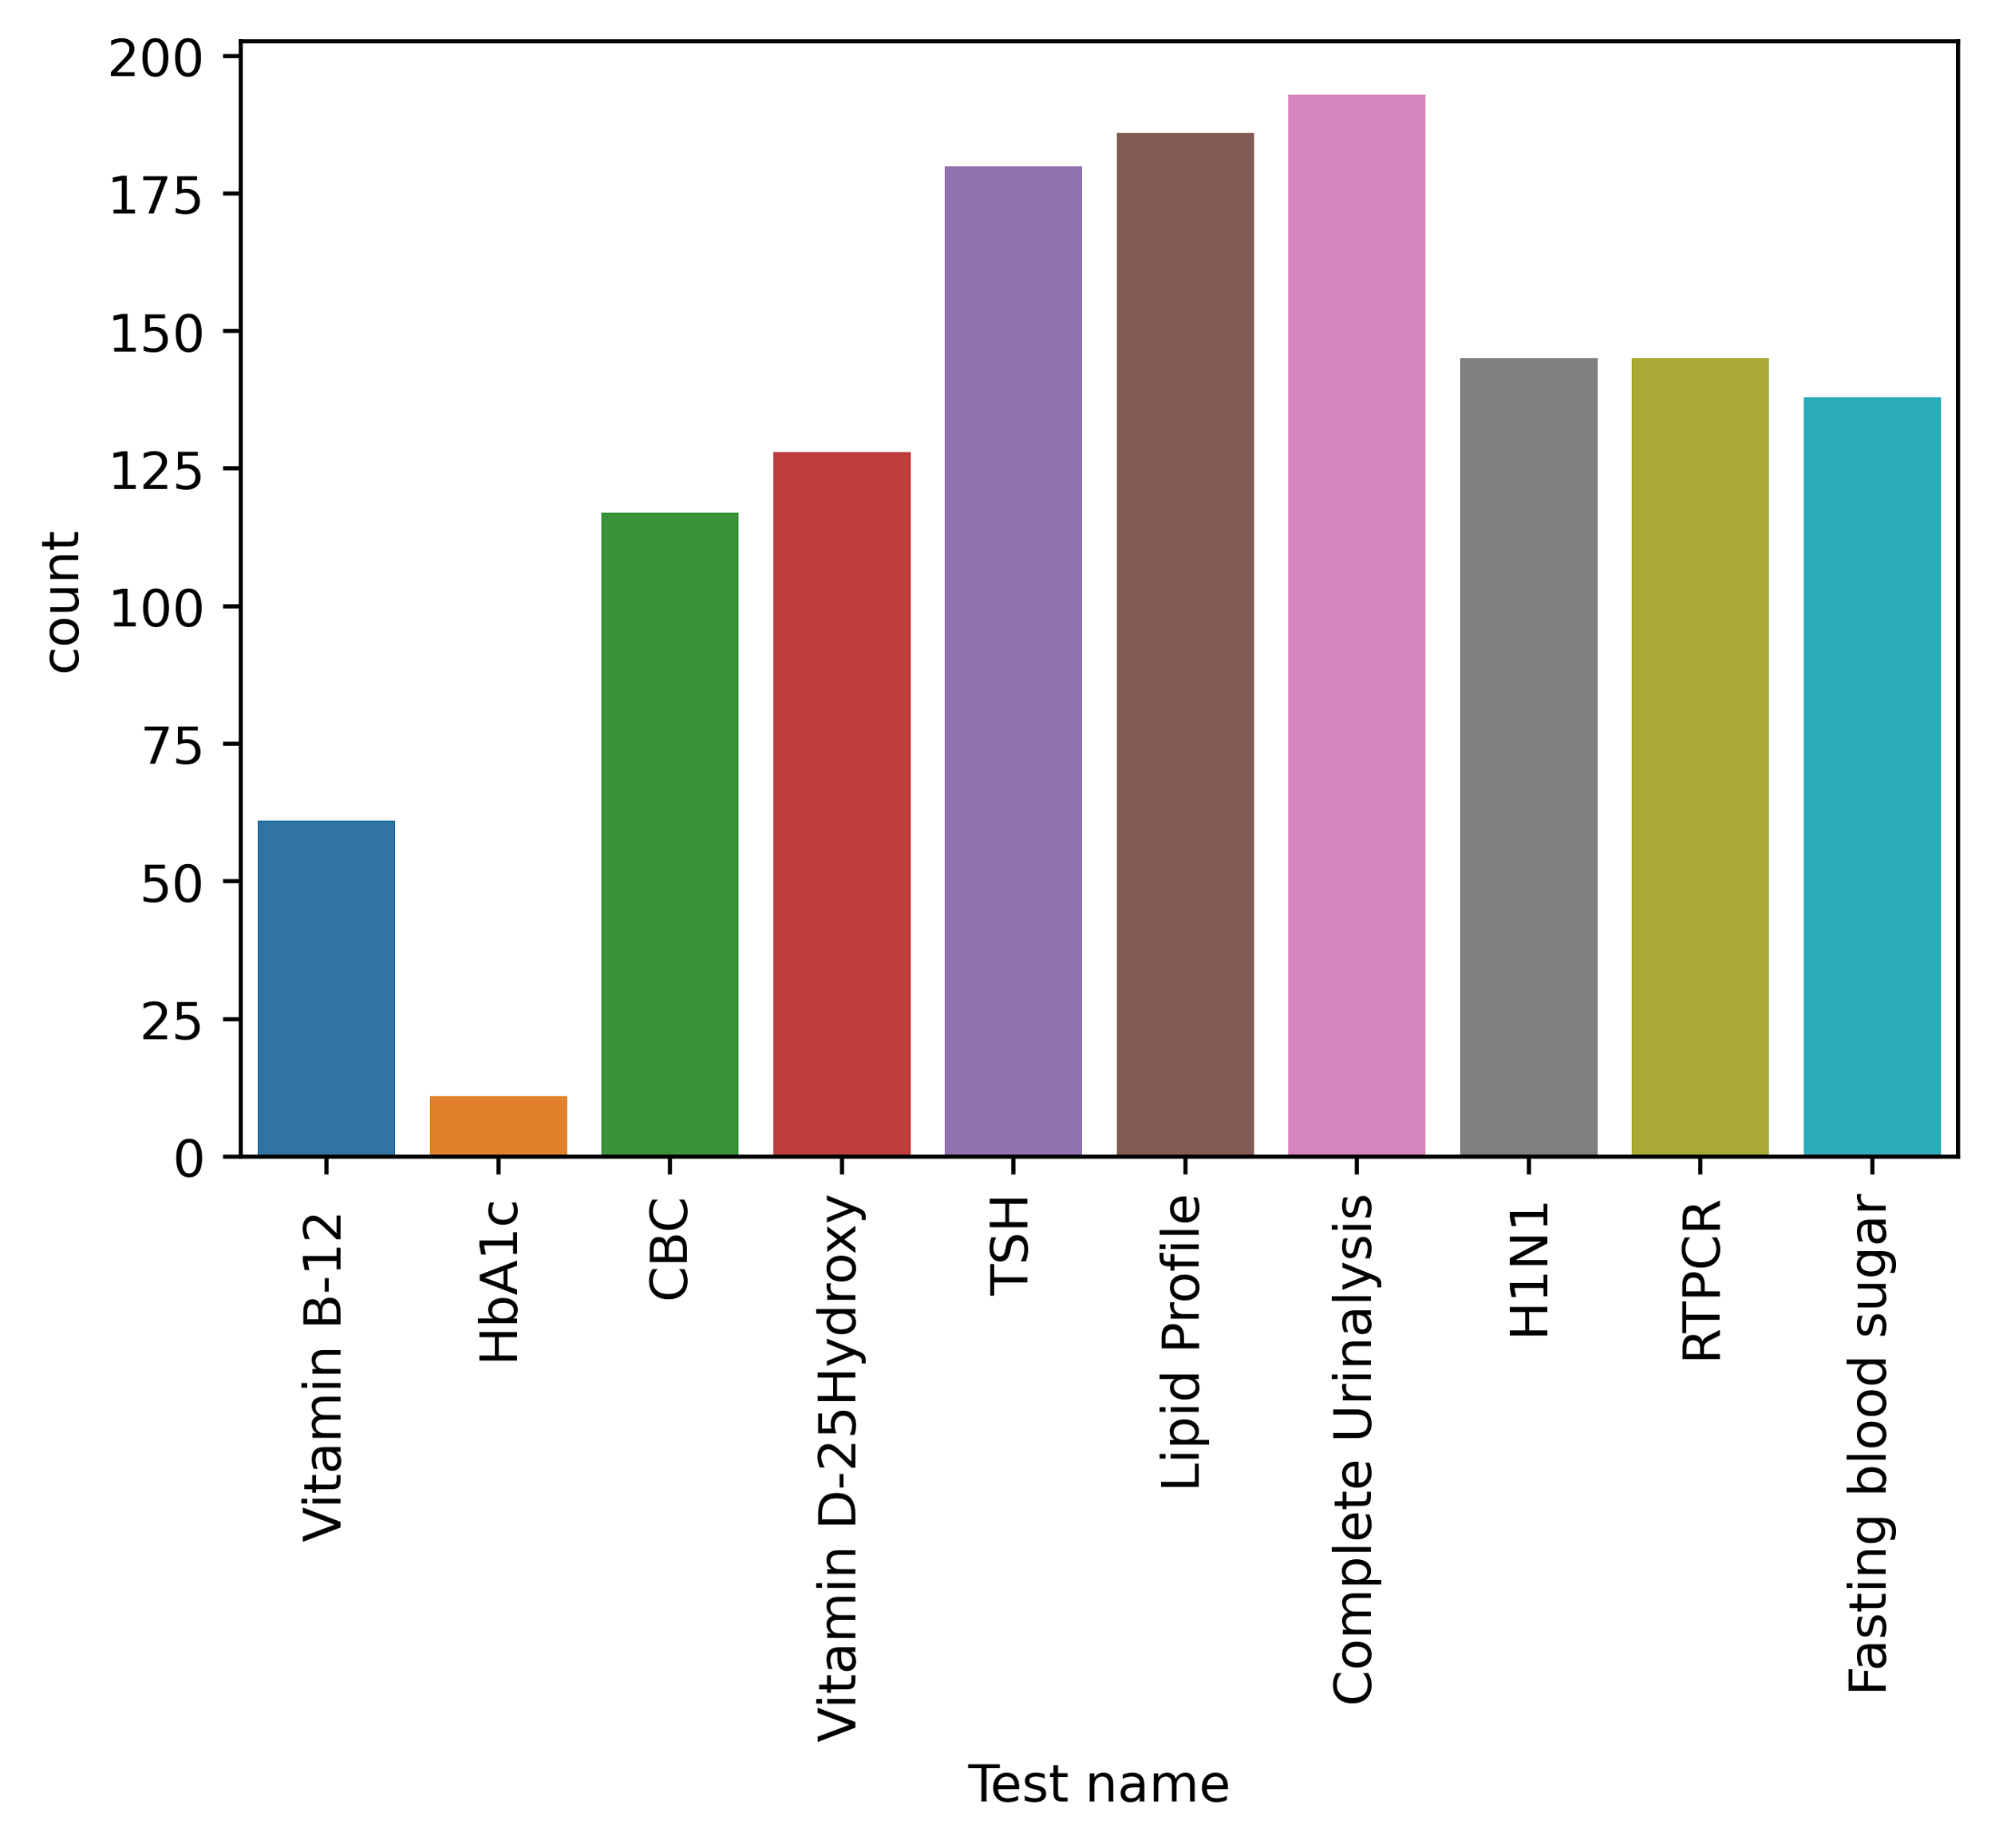
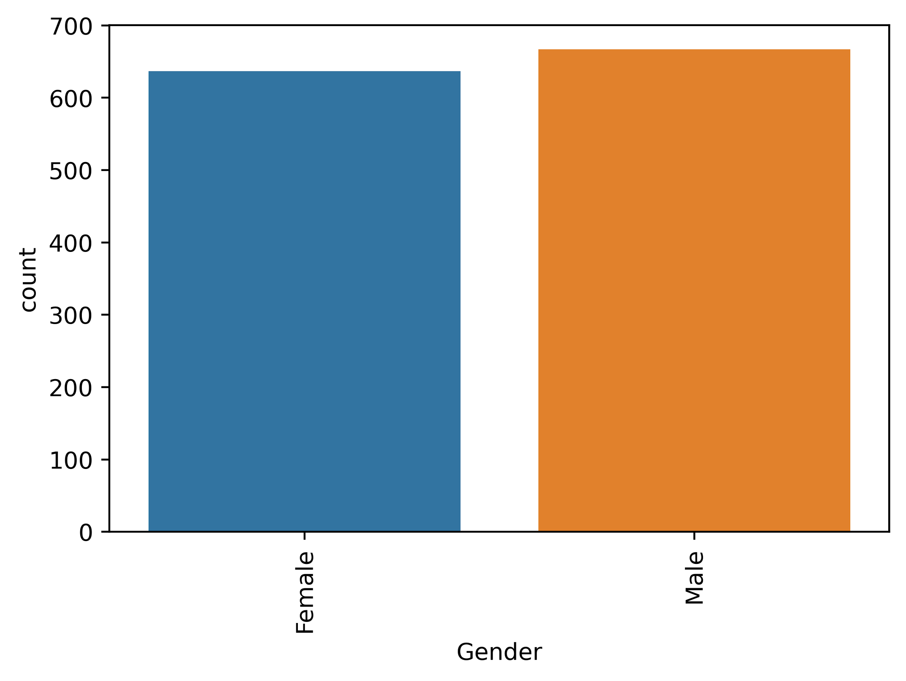

Visualization

Slide 20
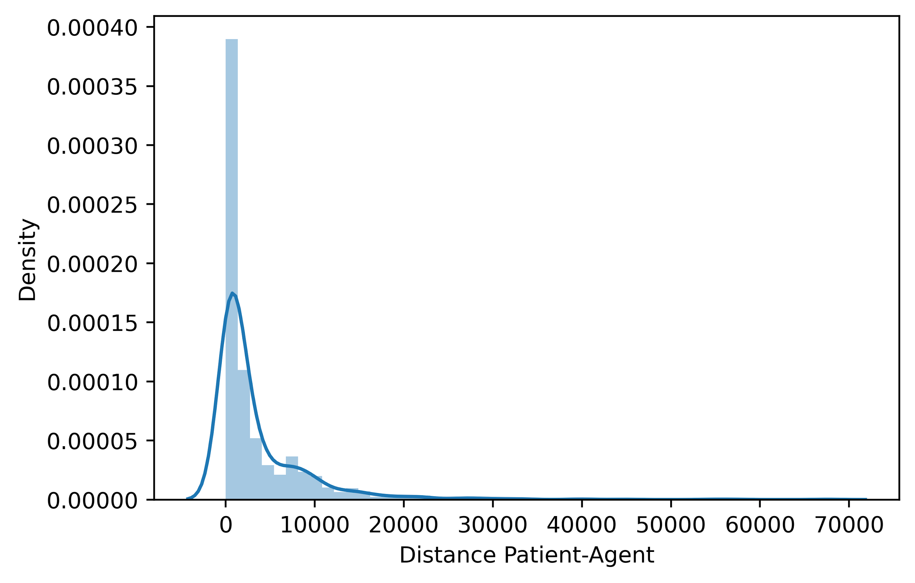
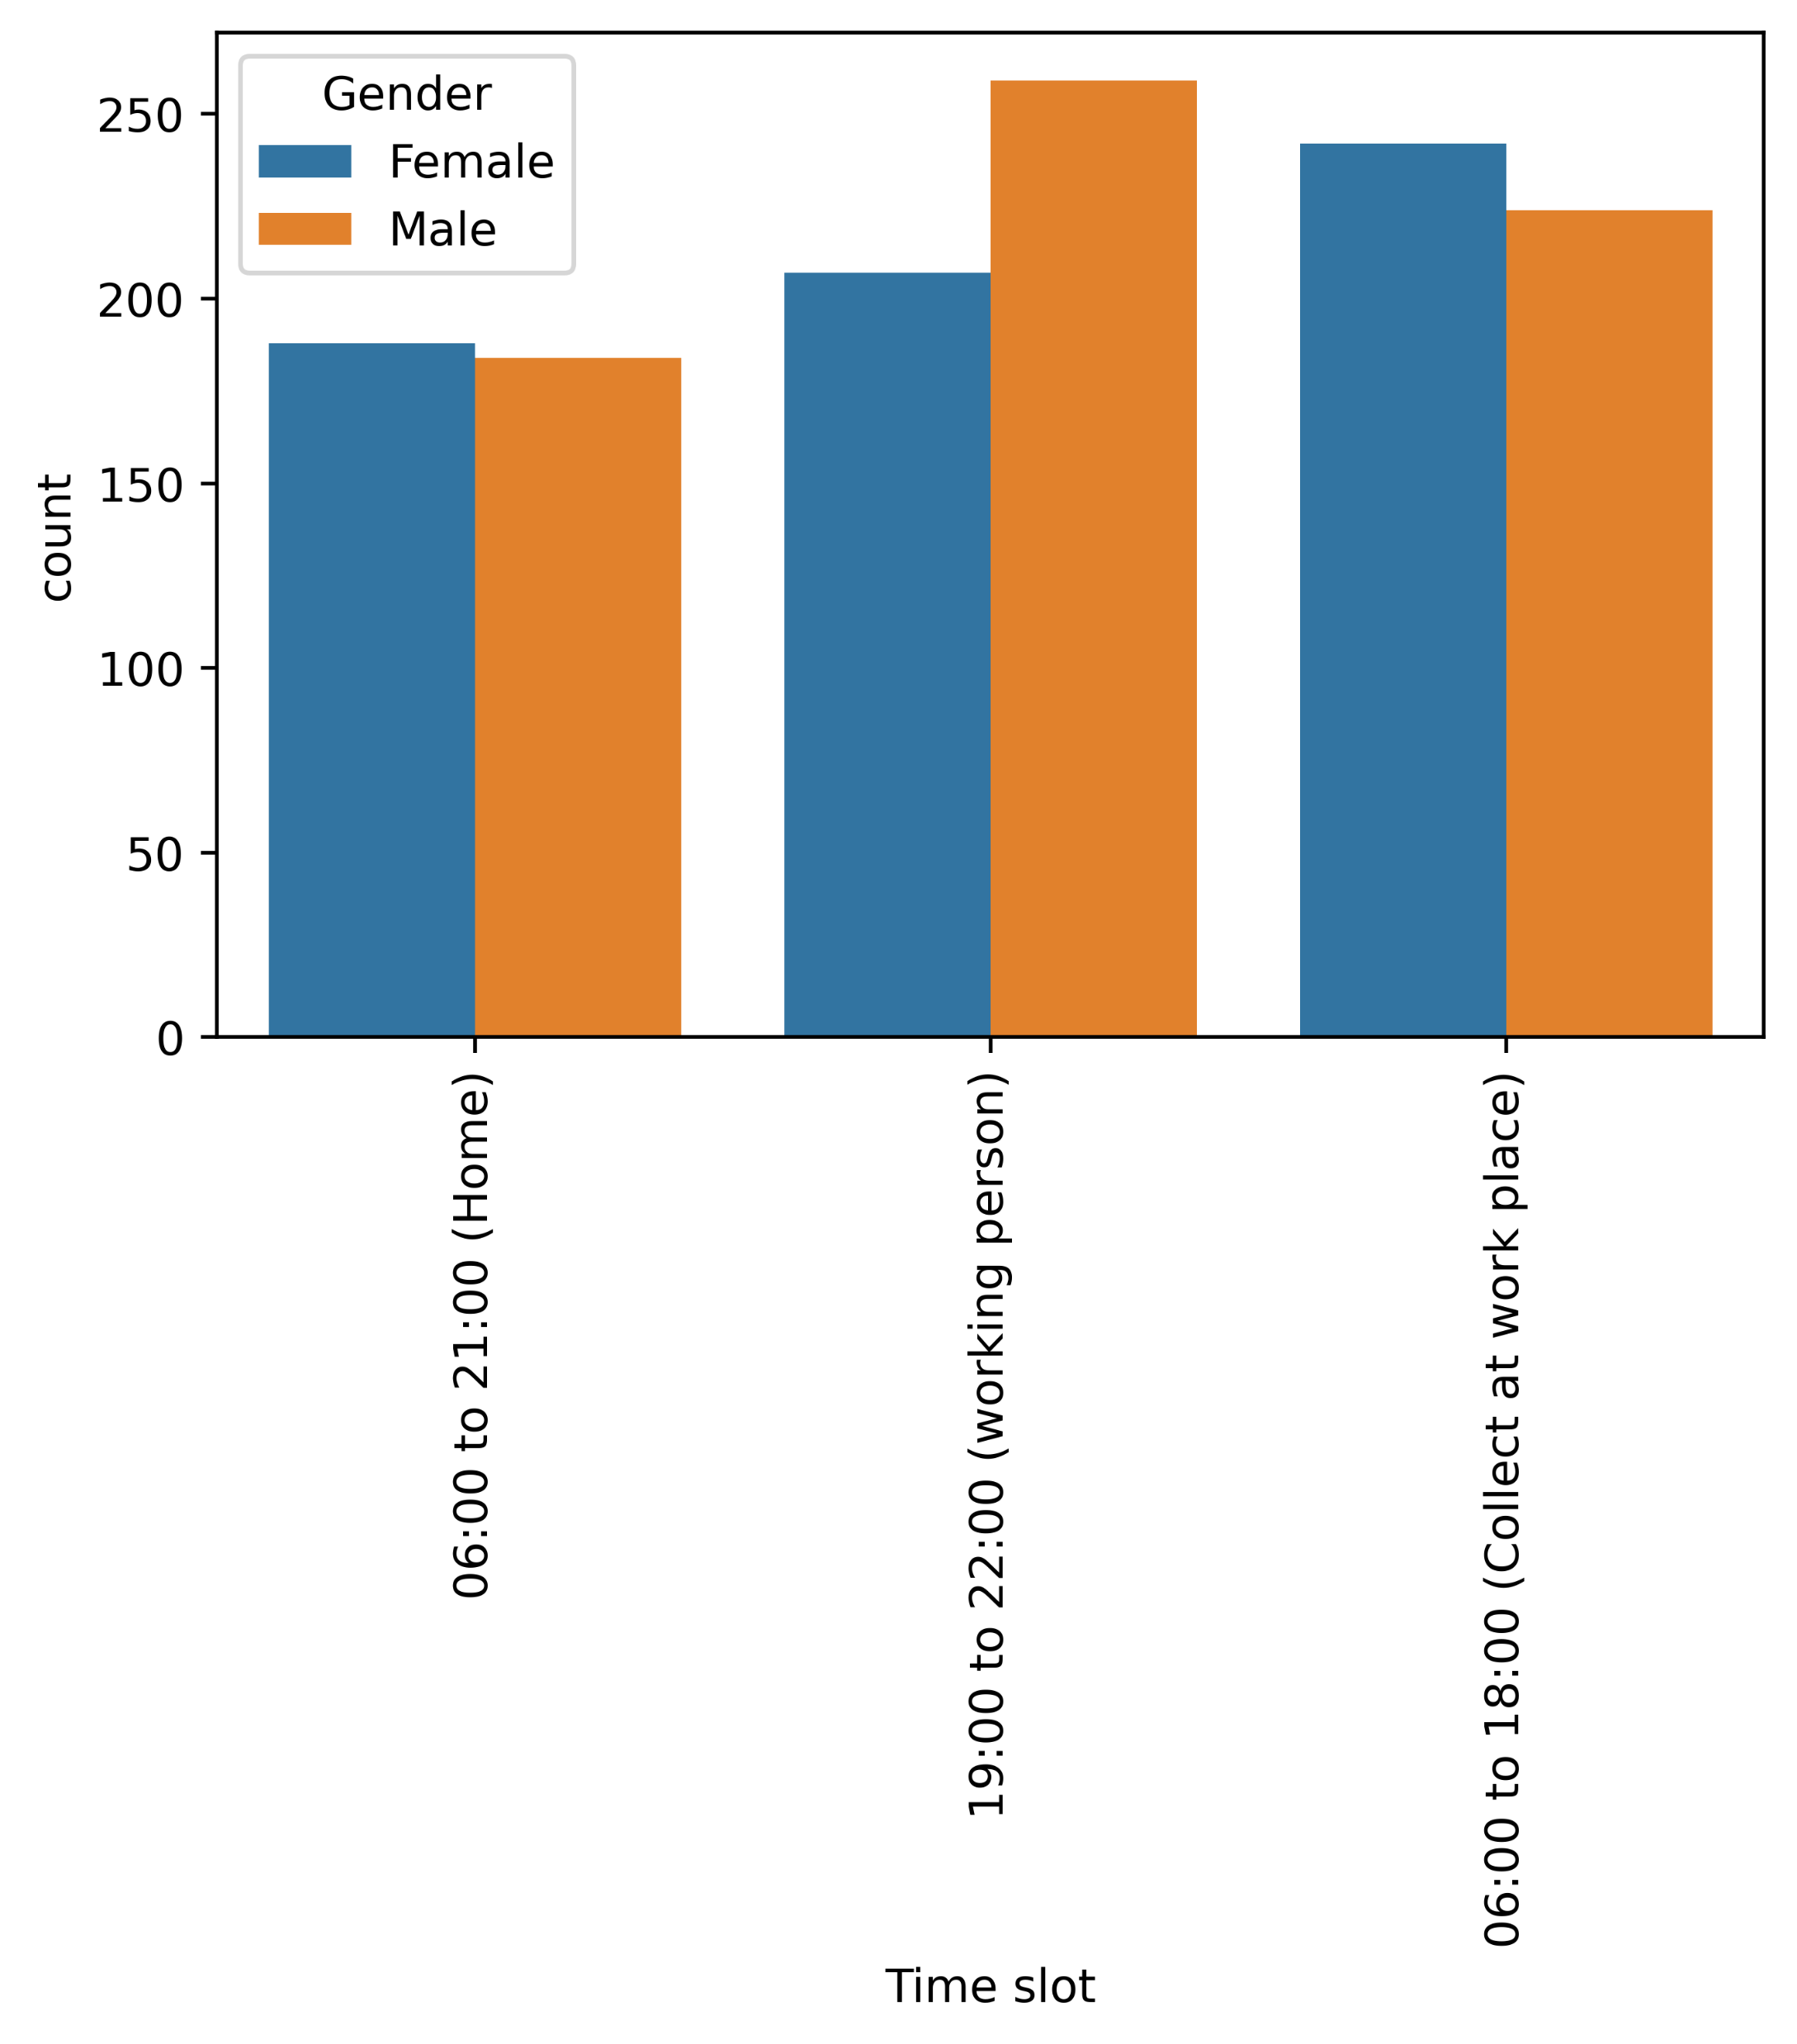
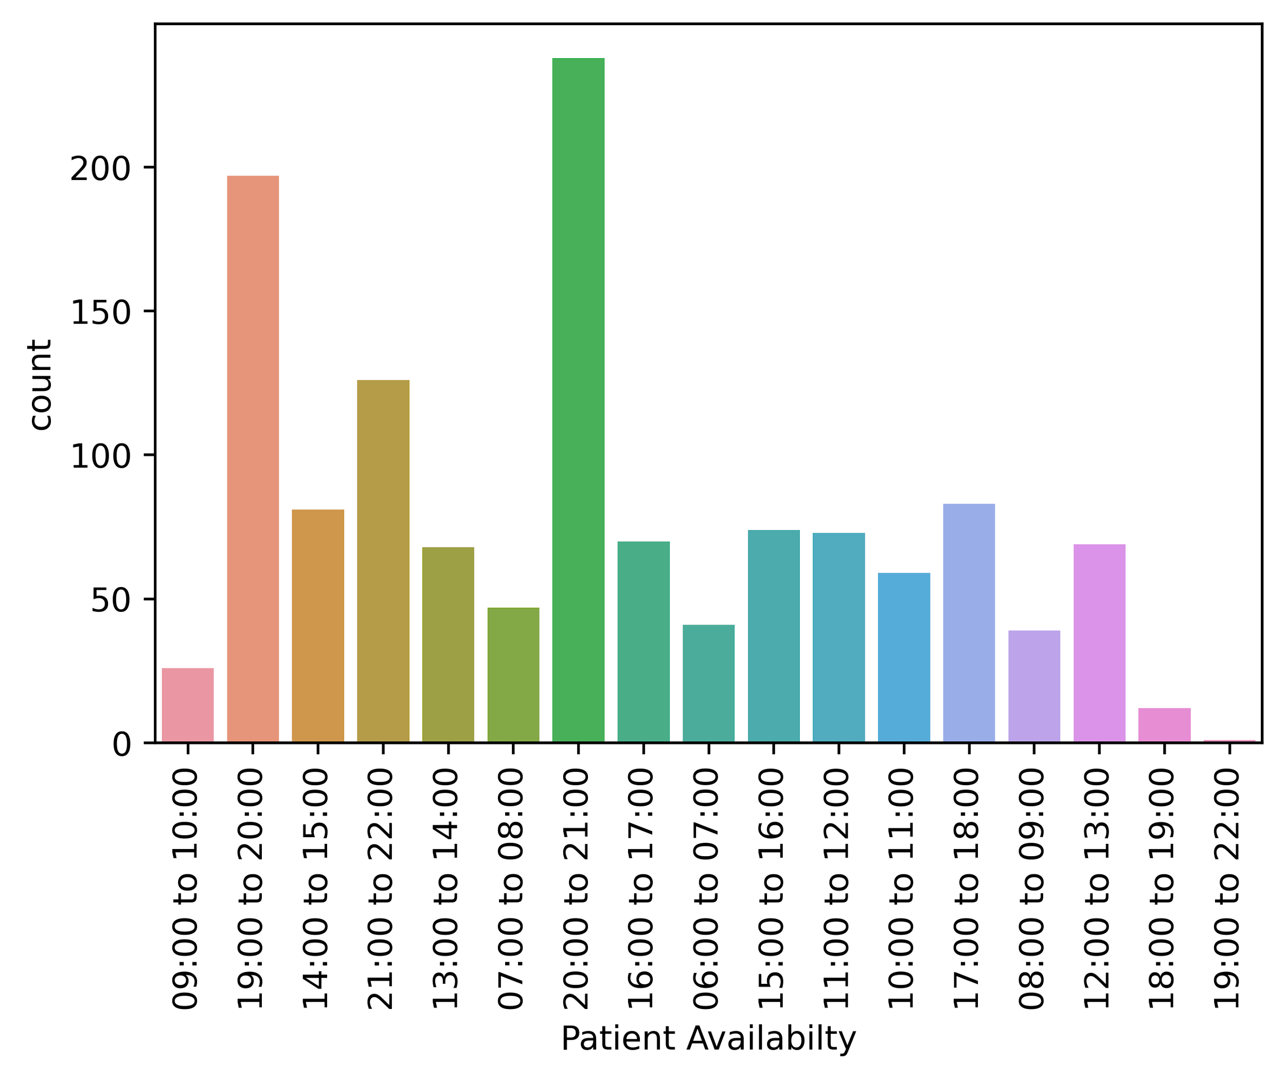
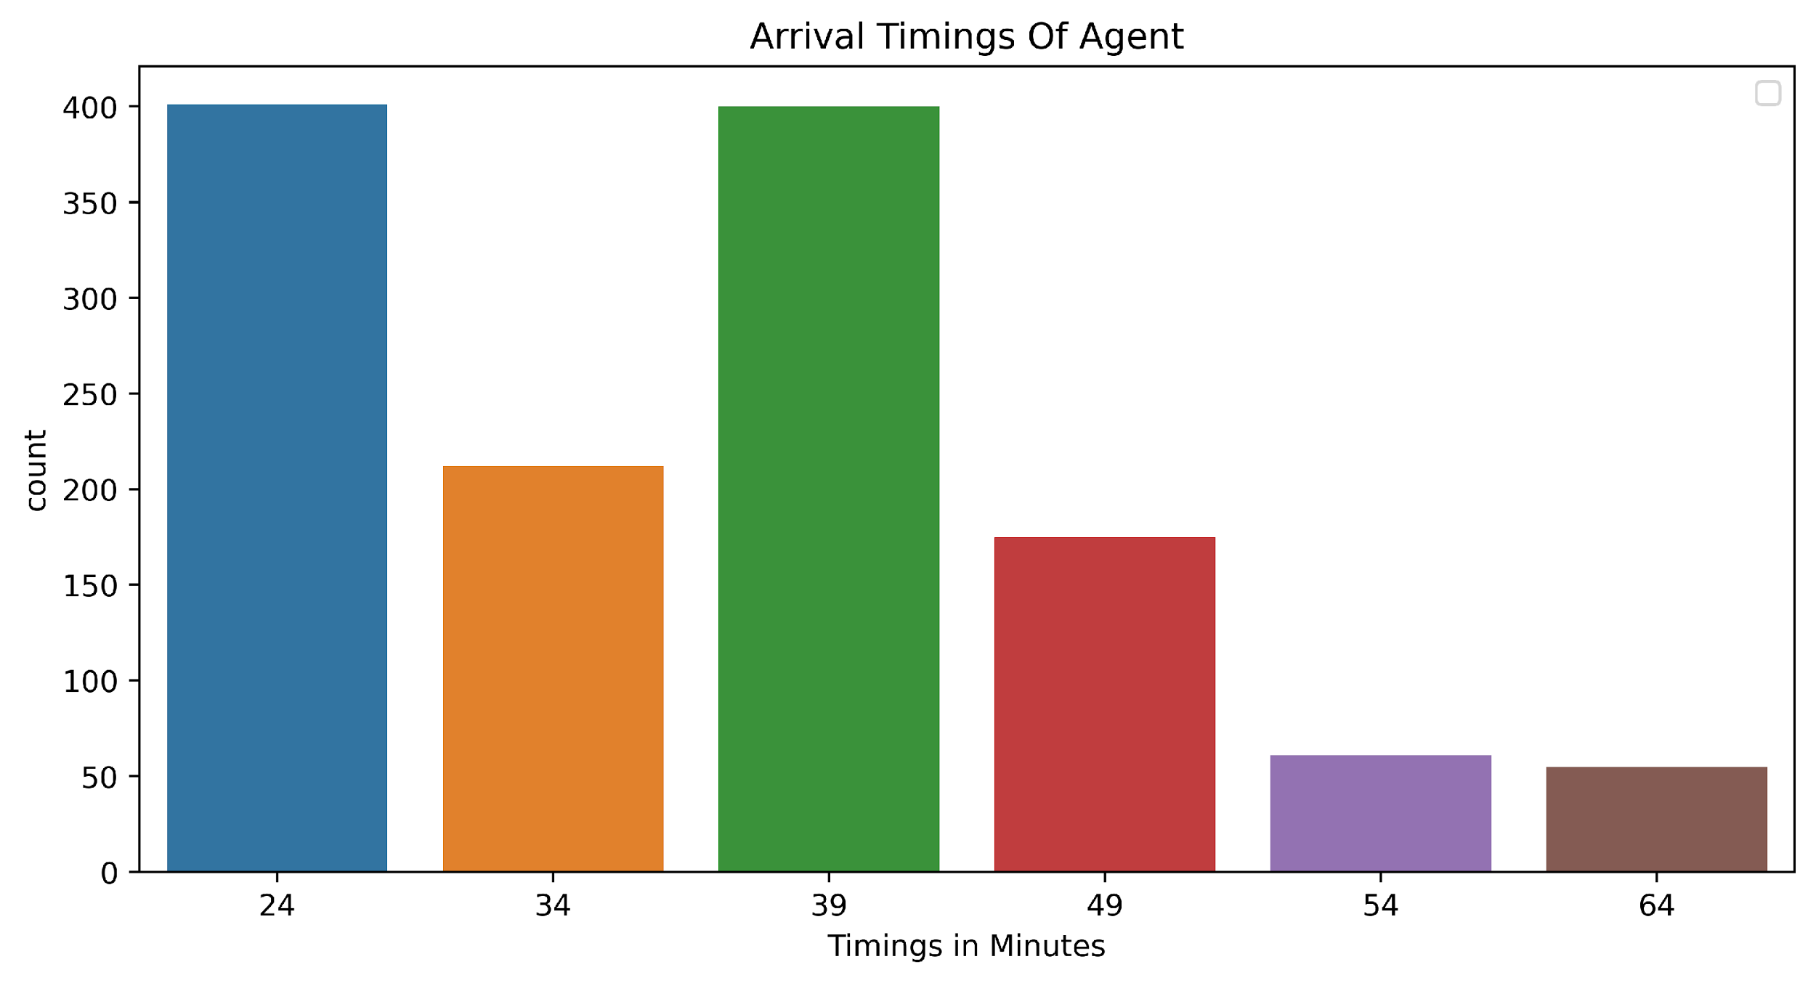
Visualization

Slide 21
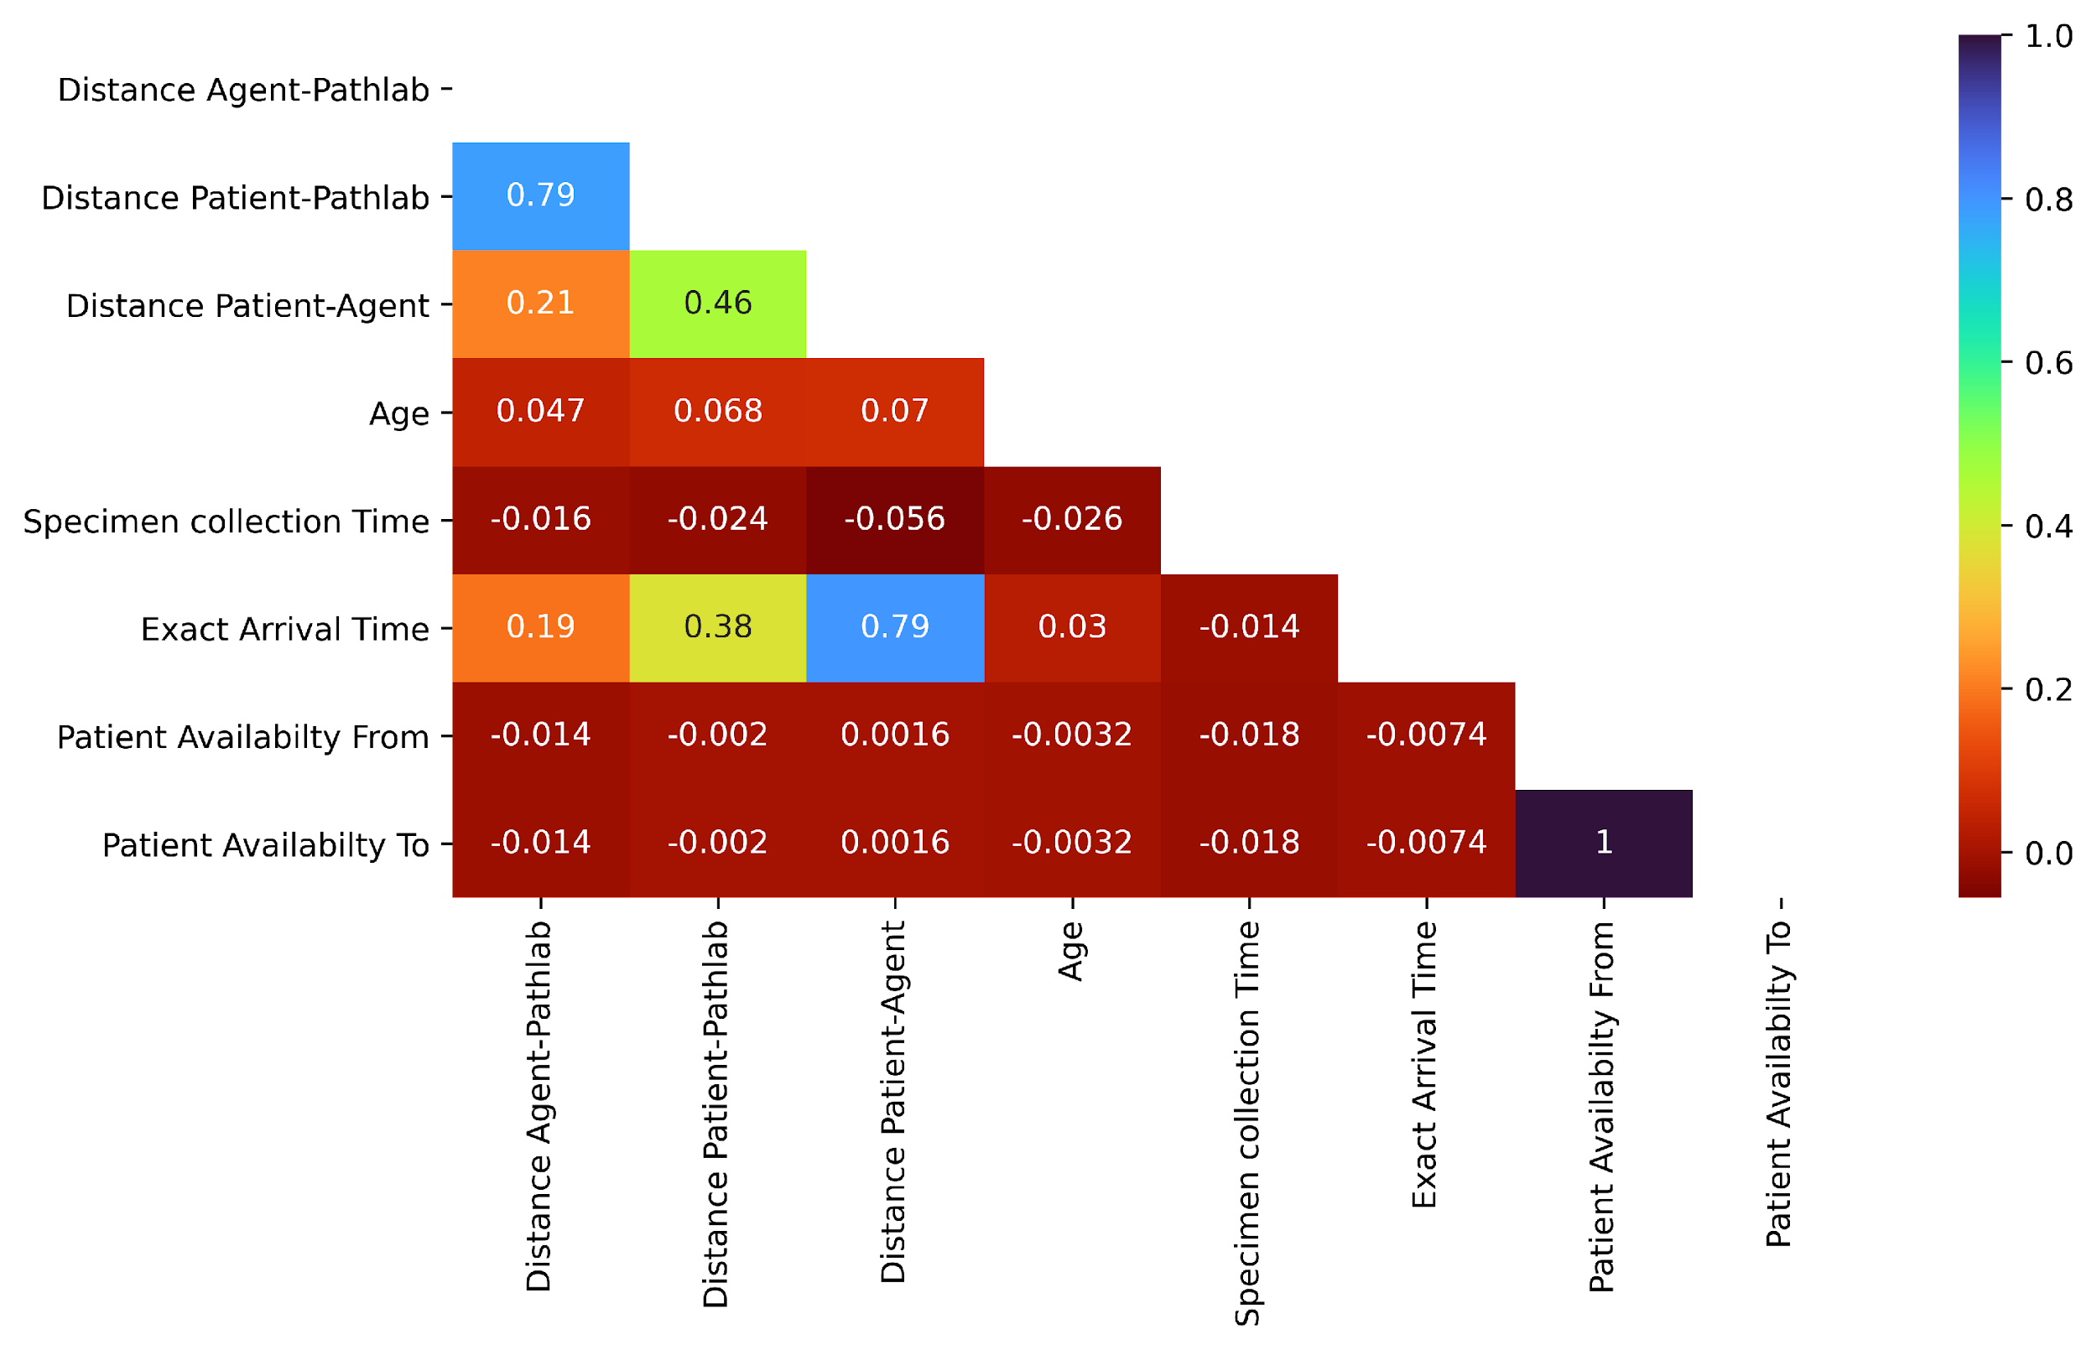
CORRELATION PLOT

Slide 22
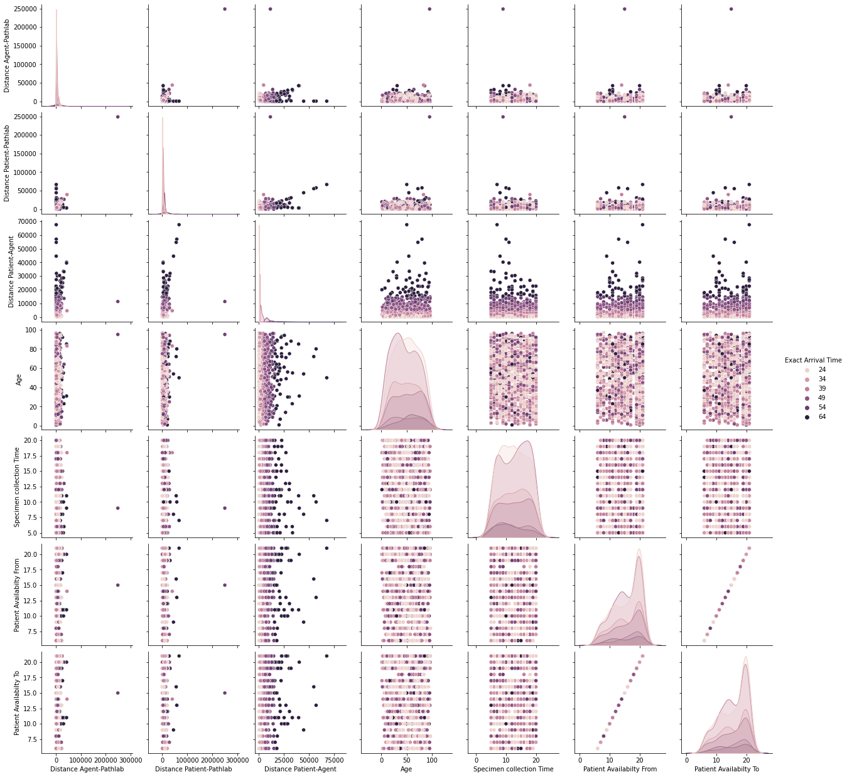
Pair plot

Slide 23
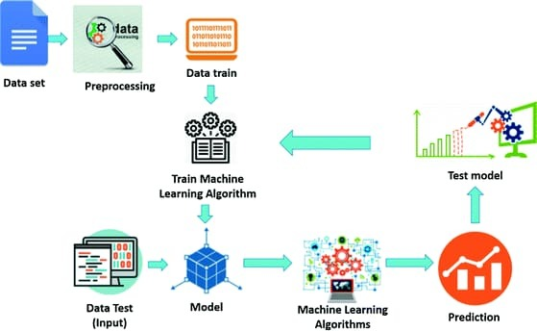
MODEL BUILDING

Slide 24
MODEL BUILDING
A machine learning model is built by learning and generalizing from training data, then applying that acquired knowledge to new data it has never seen before to make predictions and fulfill its purpose.
Packages used:
Pandas is a package used for data manipulation and analysis.
NumPy is a package used to perform a wide variety of mathematical operations on arrays.
Matplotlib is a popular Python package used for data visualization.
Seaborn is used for advanced data visualization.
psycopg2 is used to connect PostgreSQL to python.
from sklearn.preprocessing import OneHotEncoder is a function used to transform non-numerical data to numerical data.
from sklearn.model_selection import train_test_split is a function used to split data into training set and testing set.
from sklearn.compose import make_column_transformer is used to construct a
ColumnTransformer from the given transformers.
continued..

Slide 25
MODEL BUILDING
Packages used continued:
from sklearn.pipeline import make_pipeline is used to construct a pipeline from given
estimators.
from sklearn.ensemble import RandomForestRegressor is used to understand the
relationship between the dependent variable and one or more independent variables.
From sklearn.metrics import mean_squared_error, mean_absolute_error, r2_score, accuracy_score is used to get root mean square error(RMSE) and R2 score.
from sklearn.SVM import SVC is used to understand the relationship between the dependent
variable and one or more independent variables.
from sklearn.metrics import accuracy_score, classification_report is used to get accuracy classification score.
AgglomerativeClustering Unsupervised Machine Learning

Slide 26
MODEL DESCRIPTION (Regressor)
Models | Train Accuracy (%) | Test Accuracy (%) | R2 Score | Root Mean Squared Error (RMSE)
Random Forest Regressor | 98.18 | 98.08 | 0.9999 | 0.0311
Multinominal Logistic Regression | 82.74 | 77.78 | 0.8332 | 4.3218
KNeighbors Regressor | 7.77 | 4.23 | 0.3473 | 8.5487

Slide 27
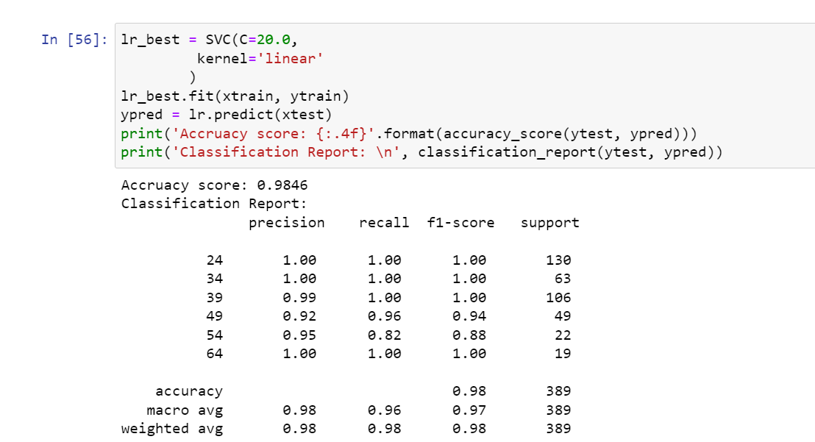
MODEL DESCRIPTION (Classification)

Slide 28
MODEL SELECTION
Model Selection refers to a technique of choosing the model that best generalizes after the individual models are evaluated based on the required criteria.
We fit and evaluated a suite of different models on the problem.
In case of Regressor Random forest gives highest R2 Score and in case of Classification model SVC gives highest Accuracy & Classification report.

Slide 29
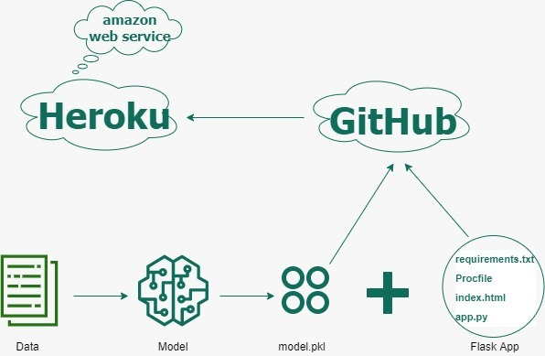
DE
MODEL DEPLOYMENT
WEB BASED

Slide 30
MODEL DEPLOYMENT
Steps for deployment on Heroku using Flask
Create ML model and save it using pickle
Create Flask files for UI and python main file (app.py) that can unpickle the machine learning model from step 1 for predictions
Create requirements. txt with all python dependencies.
Create Procfile to run Flask app
Commit files from Step 1, 2. 3 & 4 in the GitHub repo
Create account/Login on Heroku, create an app, connect with GitHub repo, and select branch
Select manual deploy on Heroku
DEPLOYMENT LINK FOR Appointment Scheduler for Sample Collection APP
Network URL: https://appointment-scheduler69-monali.herokuapp.com/
Network URL: https://datasciritwik-live-project-2022-app2-izvaer.streamlitapp.com/

Slide 31
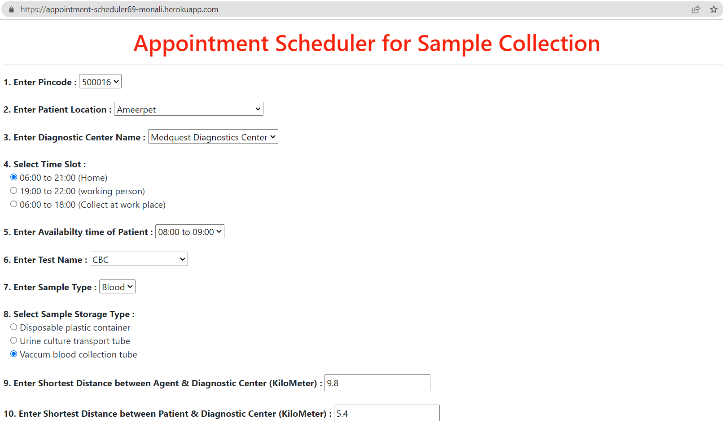
INPUTS TO APP
Outputs of
Universal Sentence Encoder:

Slide 32
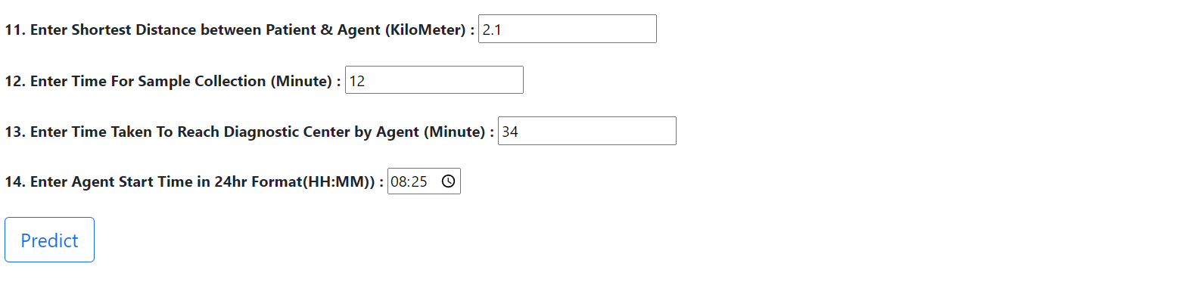
INPUTS TO APP
Outputs of
Universal Sentence Encoder:

Slide 33
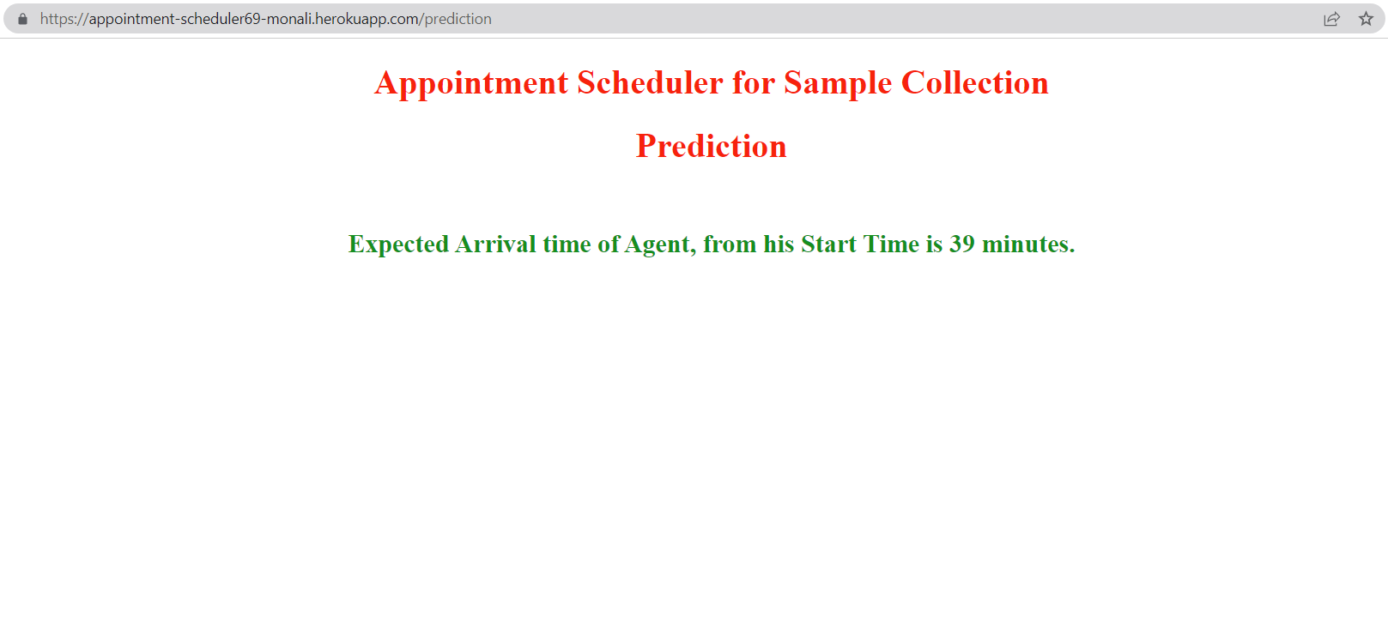
APP PREDICTION
Outputs of
Universal Sentence Encoder:

Slide 34
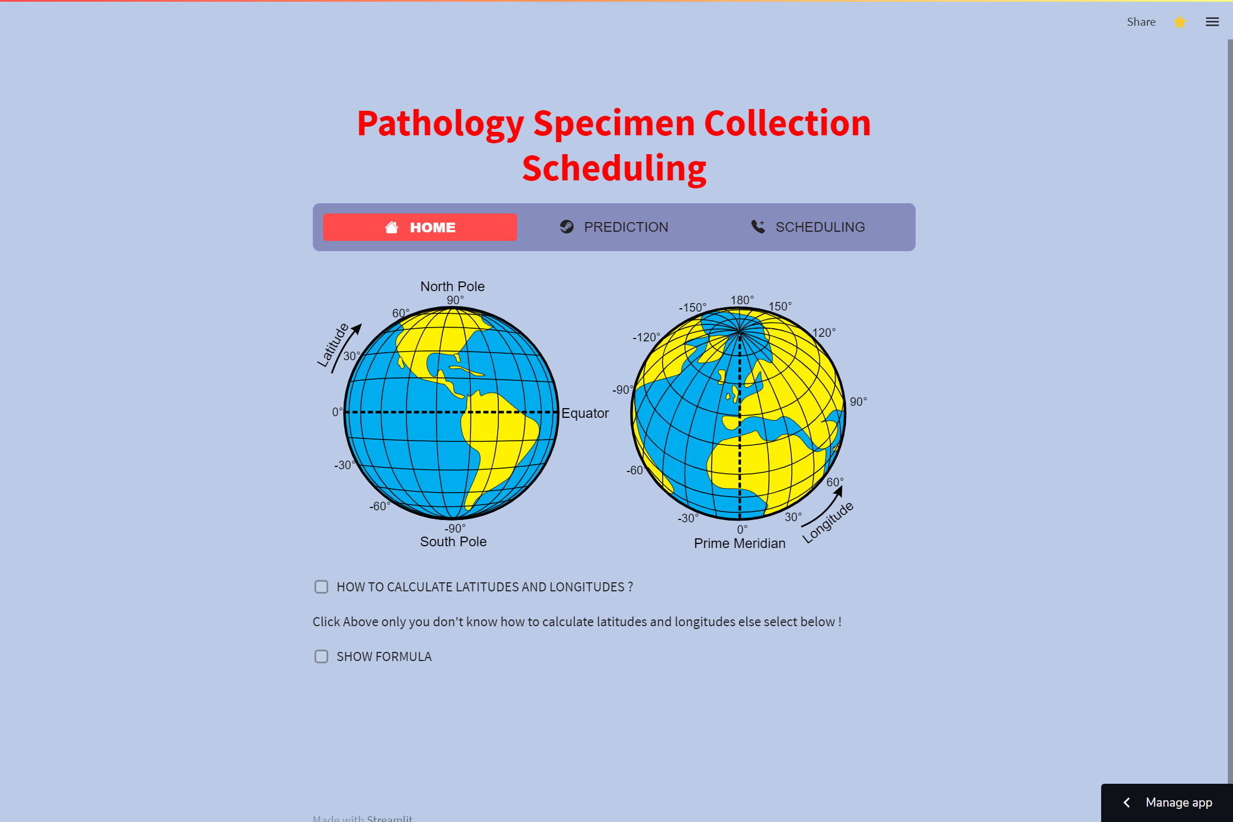
APP PREDICTION

Slide 35
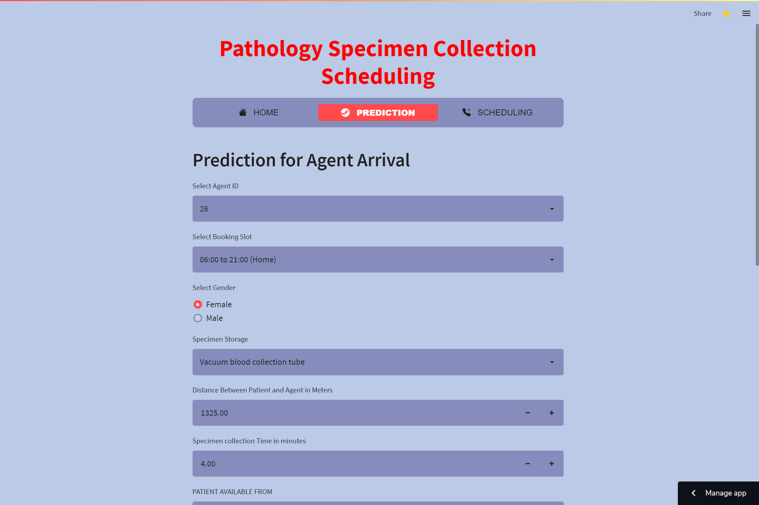
APP PREDICTION

Slide 36
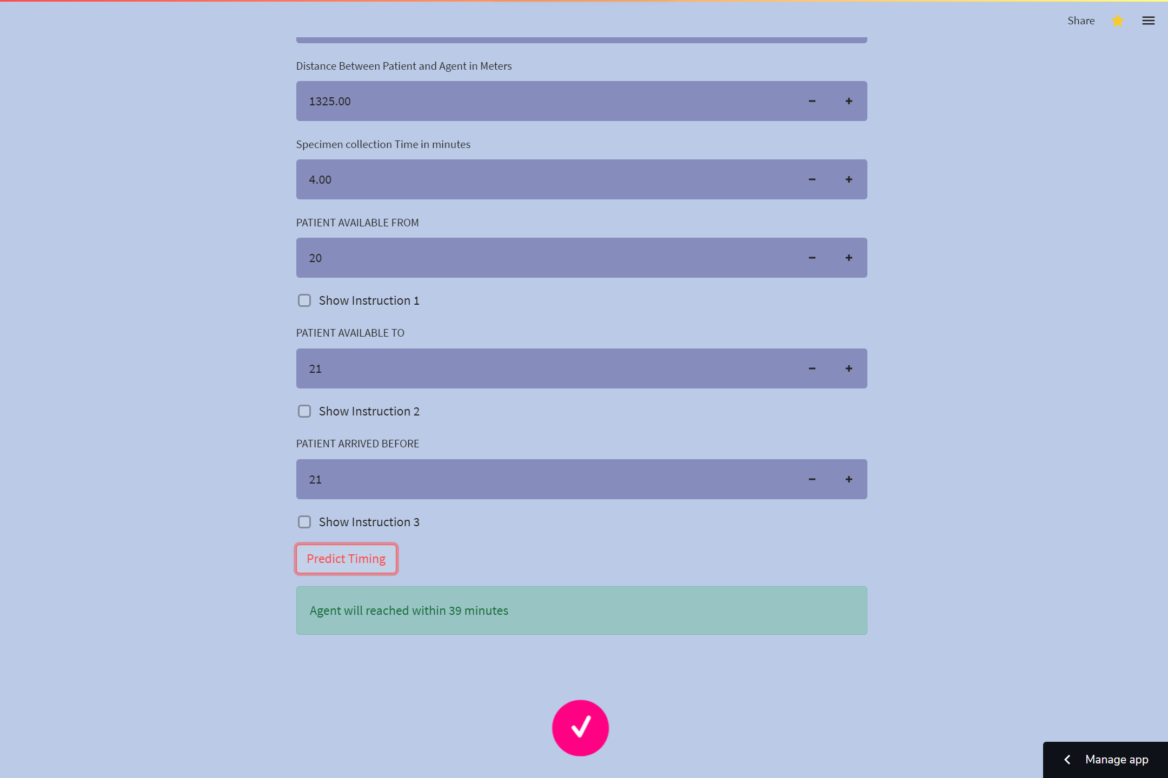
APP PREDICTION

Slide 37
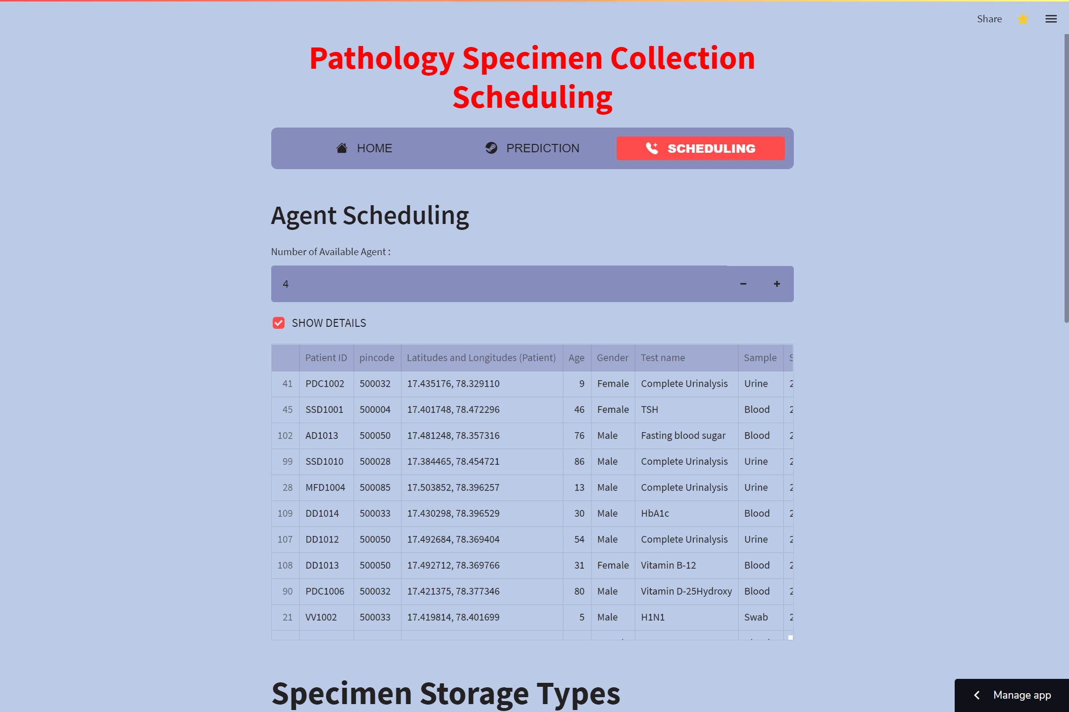
APP PREDICTION

Slide 38
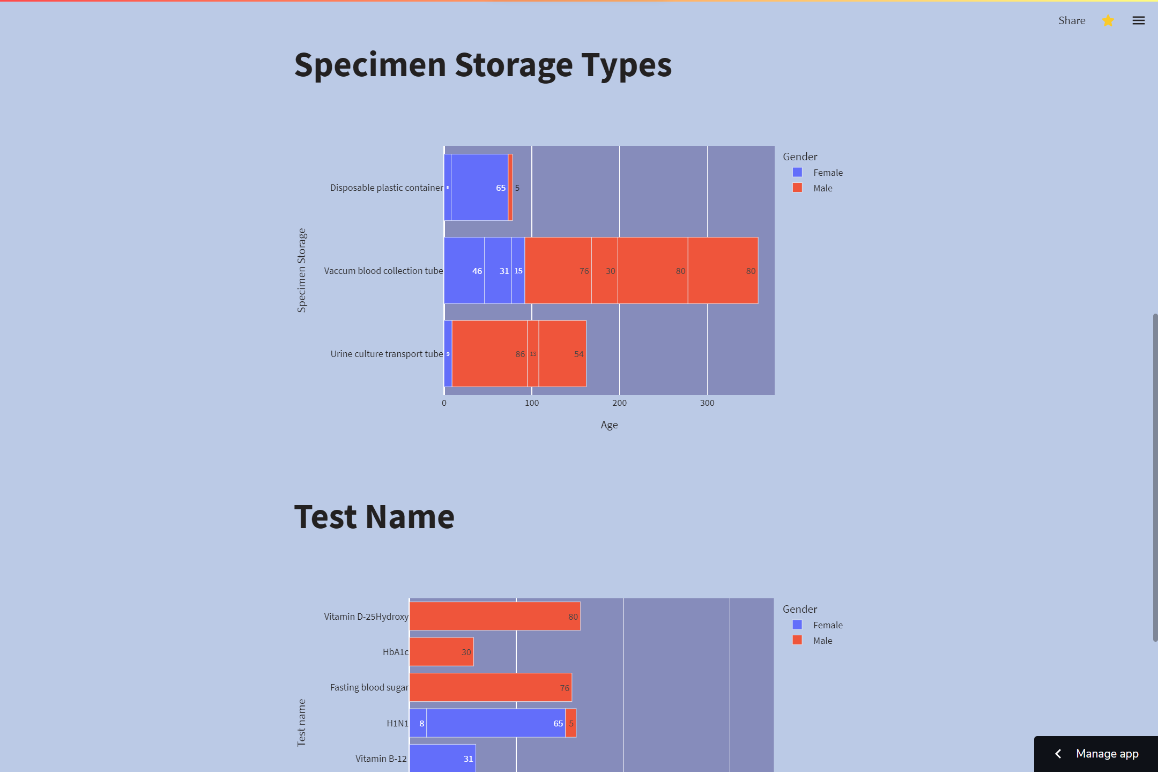
APP PREDICTION
Outputs of
Universal Sentence Encoder:

Slide 39
FUTURE SCOPE
In coming years, we can try applying data independent system. i.e. whatever be the format, our system should work with same accuracy.
It has a vast extension in future and can be actualized and interfaced with flexible and multi skilled application.
In future, there will be three problems solved by this application:-
- One thing is by knowing the majority of tests taken by patients we can consider some statistics
which help to buy those equipment in bulk .
- Updating so as to receive data from IOT devices, without depending on raw data would be beneficial.
- By knowing the places farther from which the patients are sending the request, there will a case of building a diagnostic center in such places will be profitable.

Slide 40
CONCLUSION
Machine learning can be used to know the features and characteristics of timings of sample collection, transport, sample type, other constraints and to suggest the safety of the medical sample.
The complete project comes up with the idea to help diagnostic center to decrease medical sample wastage by considering on-time delivery and helps them to yields the maximum profit.
Random Forest is a supervised machine learning algorithm which is giving highest train and test accuracy for this business problem.
So we can conclude that this model is one of the best model which is much more beneficial for Diagnostic centers.

Slide 41


